Slide 1


Presentation on Mobile Apps:
Ashish Subedi
Ashik Thapa
Suman Timsina

Slide 2
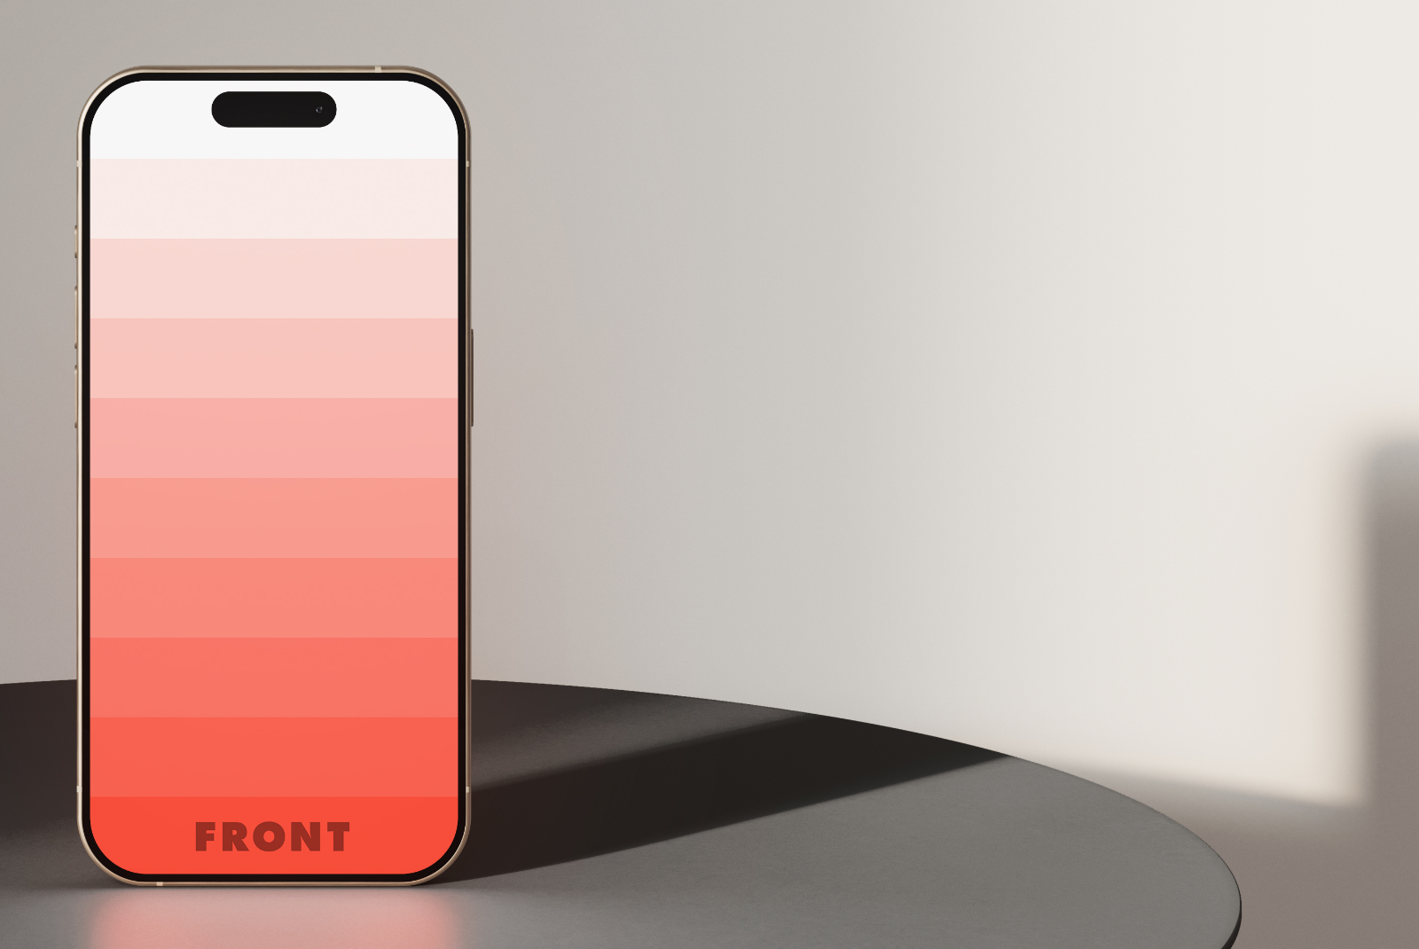
Table of Content:
Introduction
Native Mobile apps
Advantages
Web based mobile apps
Disadvantages
Types
Hybrid mobile apps

Slide 3

Types of mobile apps: 1) Native mobile apps 2) Web based mobile apps 3) Hybrid mobile apps

Slide 4

All about native mobile apps
It is specially designed for a specific device like smartphones or tablets.
Written in a specific programming language (e.g., Objective-C, Swift, Java, or Kotlin).
Advantages of Native mobile apps
More responsive, quicker, and offer a greater user experience.
Fewer bugs during development.
Disadvantages of Native mobile apps
It is time consuming development
The cost of developing native mobile apps is high.
The examples of native mobile apps are:
-Spotify -Uber -Google maps
-WhatsApp -Netflix -Instagram

Slide 5
All about Web based mobile app
They are accessed through a web browser on mobile devices and do not require installation.
Developed using standard web technologies like HTML, CSS, and JavaScript.
Advantages of web-based mobile apps
User don’t need to install the app for use.
Developers can write code once and deploy it on multiple platforms.
Disadvantages of web-based mobile apps
Web apps require a steady internet connection.
Web apps may not work well on all browsers.
Just like any website, web apps face their fair share of security challenges.
Examples of Web based mobile apps
Google Docs ●Twitter
Netflix ● Gmail
Facebook ● Trello

Slide 6

Hybrid Mobile apps
Hybrid mobile apps are applications that combine web technologies (HTML, CSS, JavaScript) with a native wrapper, allowing them to run on multiple platforms using a single codebase.
Advantages of hybrid mobile apps
Shared codebase for multiple platforms.
Quicker updates and deployment.
One codebase to maintain.
Disadvantages of Hybrid mobile apps
Slower performance
Limited access to device features
Less seamless user experience
Example of hybrid mobile apps:
Instagram Twitter Uber Evernote Ionic Pinterest Gmail

Slide 7

Thank you
Aashish Subedi
Ashik Thapa
Suman Timsina
ashisvlog12@gmail.com
aashikthapa178@gmail.com
sumantimsina803@gmail.com

